Slide 1
Business Structures

Slide 2
“Getting a job is really dumb because then you'll only get paid when you’re working.”
- Steve Pavlina, self-help author

Slide 3
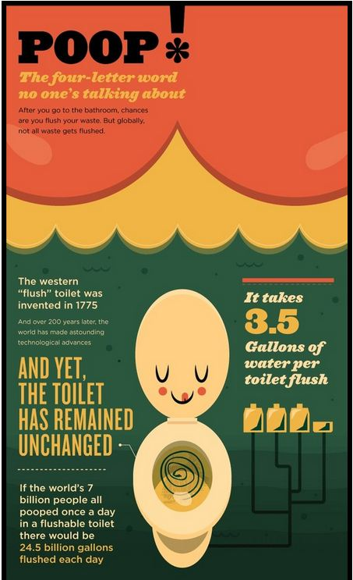
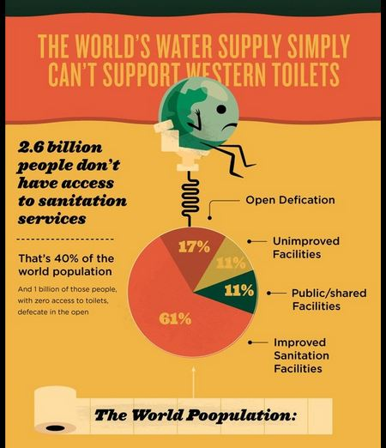

Slide 4
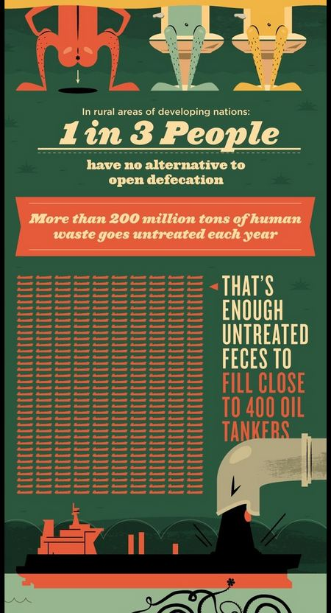
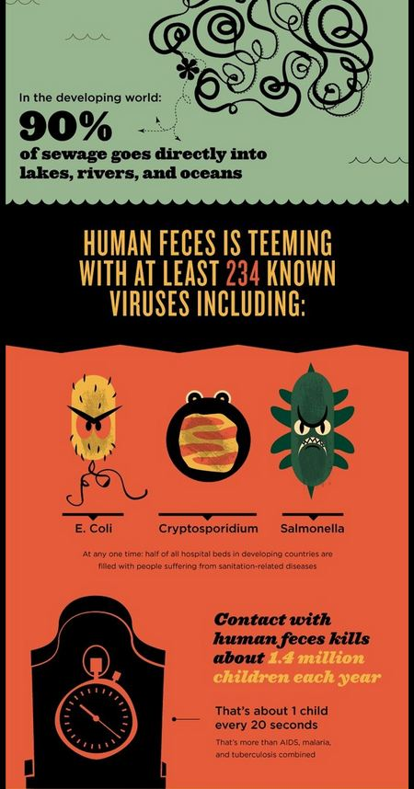

Slide 5
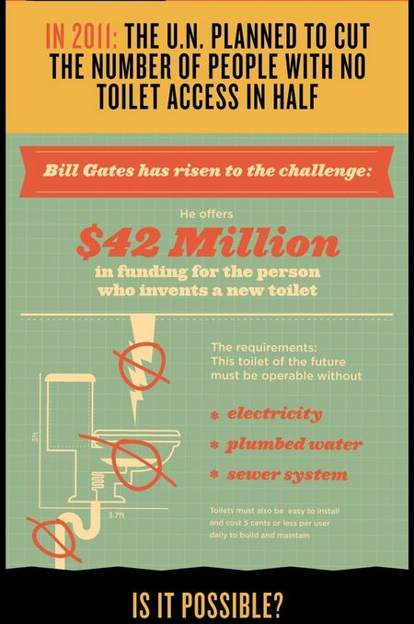

Slide 6
Business Structures
Sole Proprietorship
Partnership
Corporation
LLC
S Corporation
C Corporation

Slide 7
Sole Proprietorship
Owned and operated by one person
Business license from the city
Simple to setup, operate, and close

Slide 8
Sole Proprietorship Pros & Cons
Advantages
Independence
Easy to setup and close
Taxed to owner
Disadvantages
Unlimited Liability
Limited resources
Lack of continuity

Slide 9
Partnership
Owned and operated by two or more people
Types of Partners
General Partners - unlimited liability
Limited Partners – liability limited to amount of investment

Slide 10
Partnership Pros & Cons
Advantages
Pooled talent and resources
Easy to form
Taxed to owners
Disadvantages
Unlimited Liability
Potential for management conflict
Transfer of ownership issues

Slide 11
Corporation
Business entity separate from its owners and managers
Owners own stock (shares) in the corporation
Generally larger than other forms

Slide 12
Corporate Characteristics
Separate Legal and Tax Entity
Shareholders
Ultimate owners, elect Board of Directors
Board of Directors
Have management and control of corporation
Elected by shareholders
Officers
Appointed by Board of Directors
Represent and operate the company

Slide 13
Corporate Structure

Slide 14
Corporate Characteristics
Charter (aka Articles of Incorporation)
Issued by a state
Name & address of incorporators
Purpose
Authorized stock, classes, rights of stockholders
Bylaws
Rules and regulations by which it operates
Minute Book
May be just one person

Slide 15
Stockholder Rights
Common Stock
Votes in corporate matters (one vote per share)
Preferred Stock
No voting rights
Dividend claims are paid 1st
Dividend
Distribution of earnings to the stockholders of a corporation

Slide 16
Types of Corporations
C Corporation
regular corporation, separate legal and tax entity
S Corporation
Separate legal entity, but not a separate tax entity
Limited liability of a corporation
Taxed to owners like a partnership
Limited-Liability Corporation (LLC)
Limited liability without S Corp restrictions
Most popular form for startups

Slide 17
Corporation Pros & Cons
Advantages
Limited liability
Increased access to resources
Transfer of ownership
Disadvantages
Expensive to start
Complex to maintain
Double Taxation

Slide 18
Double Taxation
 | Sole Proprietorship | Corporation
Income | 1000000 | 1000000
Expenses | 300000 | 300000
Income Before Taxes | 700000 | 700000
Corporate Tax (20%) |  | 140000
Net Profit | 700000 | 560000
Personal Tax (30%) | 210000
Dividend Rate (20%) |  | 112000
 | 490000 | 448000

Slide 19
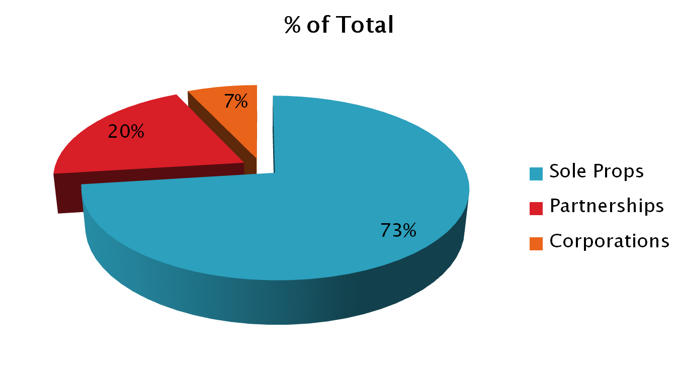
Forms of Business

Slide 20
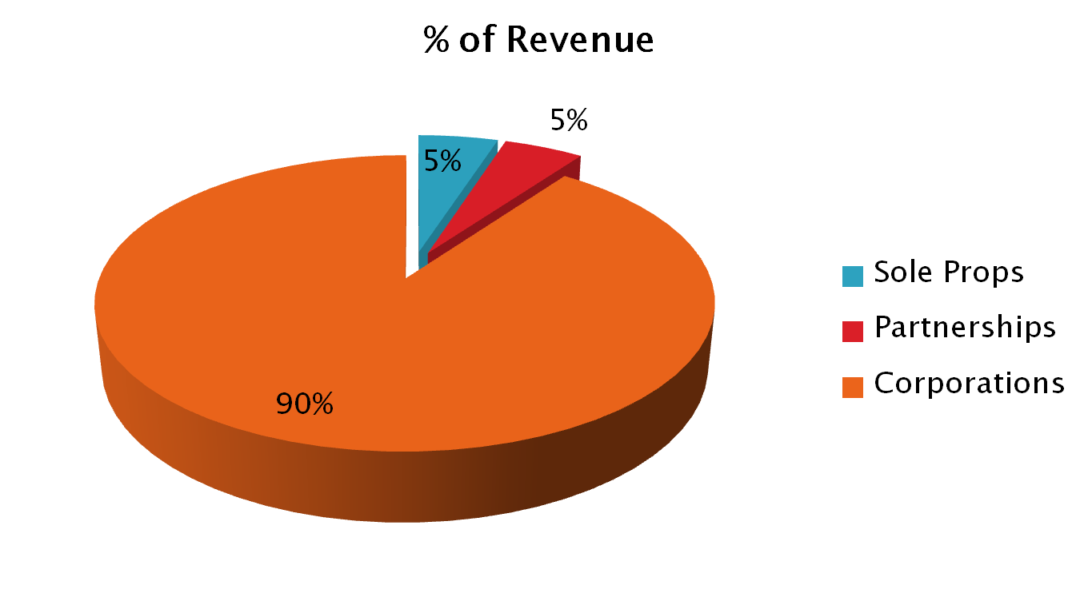
Forms of Businesses

Slide 21
Franchising
Franchise
The business itself
License to operate an individually owned business as though it were part of a chain of outlets or stores
Franchising
Granting of a franchise

Slide 22
Franchising
Franchisor
Supplies a known & advertised business name
Supplies management skills
Supplies training & materials
Supplies method of doing business
Franchisee:
Supplies labor & capital
Operates the franchised business
Agrees to abide by the franchise agreement

